Slide 1


Facebook Ad Performance Prediction System
Edwin Tam Wei Ching | - | A0178396J
Lin Jun Liang | - | A0178295M 30 Jan 2020

Slide 2

Agenda

Slide 3
Problem Domain Overview
System / Project Description
Results
Benefits
Demo
Q&A

Slide 4

Problem Domain Overview

Slide 5
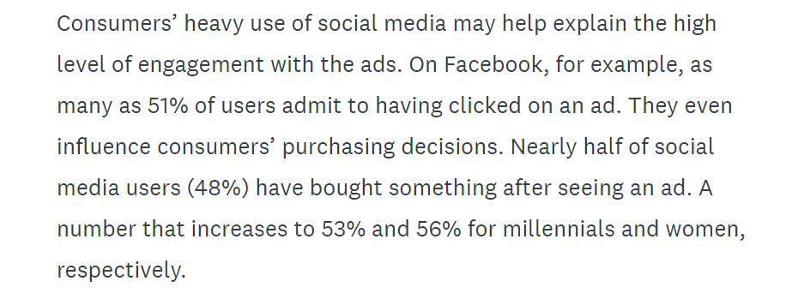
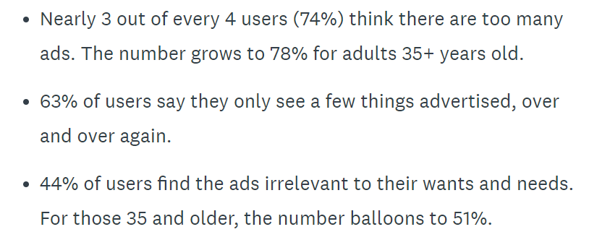
2019 April CMO Survey
Source: https://www.surveymonkey.com/curiosity/74-of-people-are-tired-of-social-media-ads-but-theyre-effective/

Slide 6
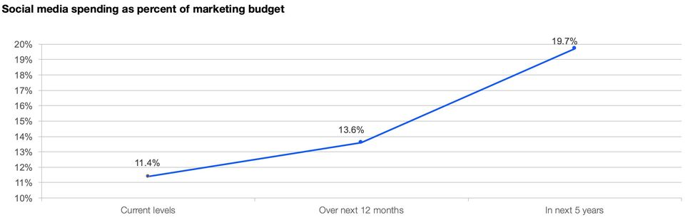
2019 April CMO Survey
Marketing leaders predict spending to increase 73% to reach 19.7% of their marketing budgets over the next five years, on average
Source: https://www.forbes.com/sites/christinemoorman/2019/04/23/why-social-media-performance-lags-even-as-spending-soars/#5707bcaf1baf

Slide 7
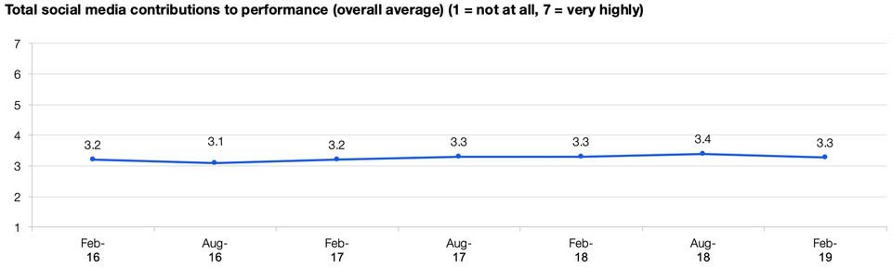
2019 April CMO Survey
Social media’s contribution to enterprise performance has been relatively modest
Source: https://www.forbes.com/sites/christinemoorman/2019/04/23/why-social-media-performance-lags-even-as-spending-soars/#5707bcaf1baf

Slide 8

Project Description

Slide 9
What gets clicks on a social media advertisement?

Slide 10
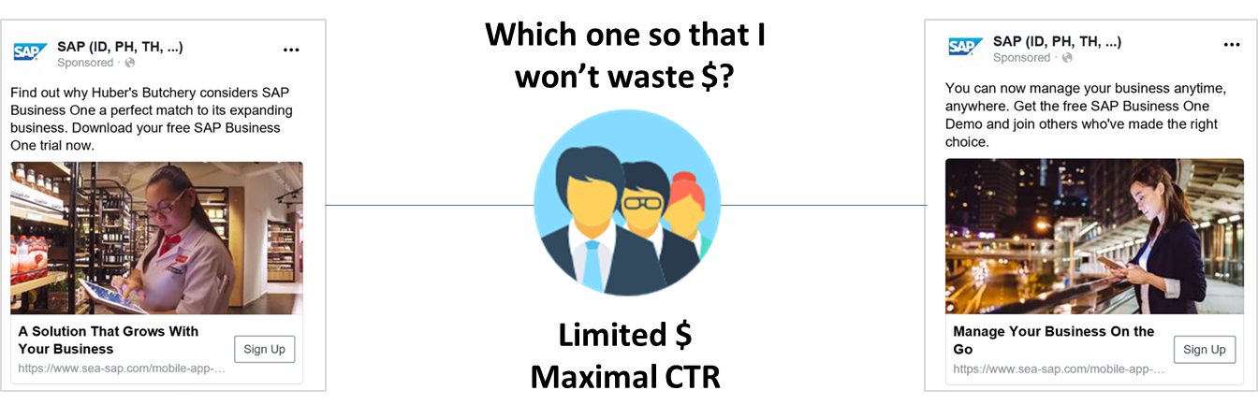
Predict a social media advertisement’s cost-per-click (CPC) before it goes live

Slide 11
Solution Outline
Extract data & ads from Facebook
Ad Copy
Identify objects in ads images (Image.ai; Model: ResNet Coco)
Build Predictive Model on Ad Features + Performance
XGBoost Linear Ensemble
Evaluate System
Predicted vs Actual Campaign results
Filter & Transform Dataset
Extract Ad Features
Remove Ads with CPC = 0 or NULL
Select only EN ads that use Images + Text only
Improve System
Ad Creative
Performance measures (CPC, Clicks, Reach)
Targeting Parameters (Interest, Work Titles, Countries)
Select only Campaign Objectives: LINK_CLICK, LEAD_GENERATION, CONVERSION
Add Metadata
TF-IDF ad body copy
1-Hot interests, work titles, and countries
Matrix of Features for use in model
Filter irrelevant ads from the dataset & prepare target variable
Data on hand
Winning Model
Log Transform target variable CPC
Back Transform from Log prediction to Base 10
Other models
XGBoost Tree Ensemble (classification on 5 bins of CPC equal distribution)
Linear Regression
MLP
Evaluate
New ads will have new Ad Features. Add into Matrix of Features
Retrain model
Supermetrics
Python
Knime

Slide 12















Technical Architecture
Data Sources
Analytics
User Access
Data ingestions Sub-system
In-house system
Data Modelling Sub-system
Extract
Ingest
Store
Prep & Train
Model & Serve
Facebook Ad
Platform
Local Storage
Ad Benchmarking
Tool
Marketers
Image recognition
engine
Model simulation engine

Slide 13
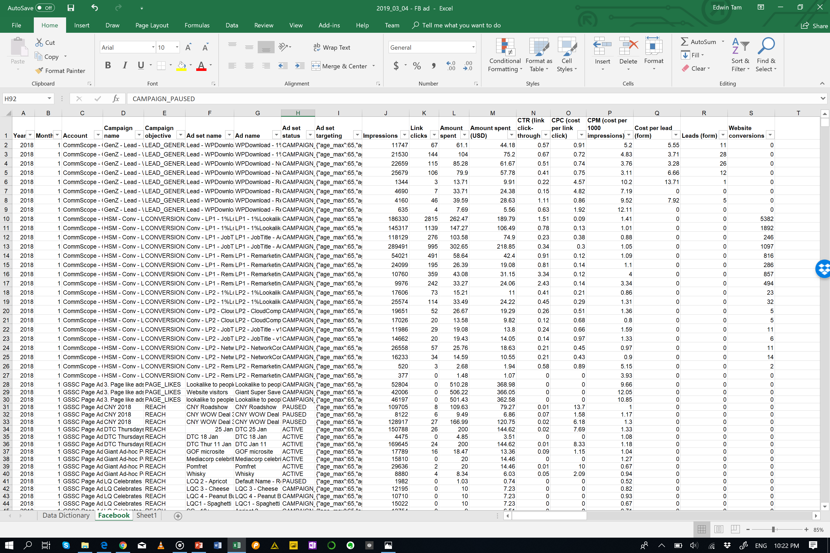
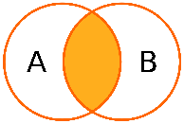
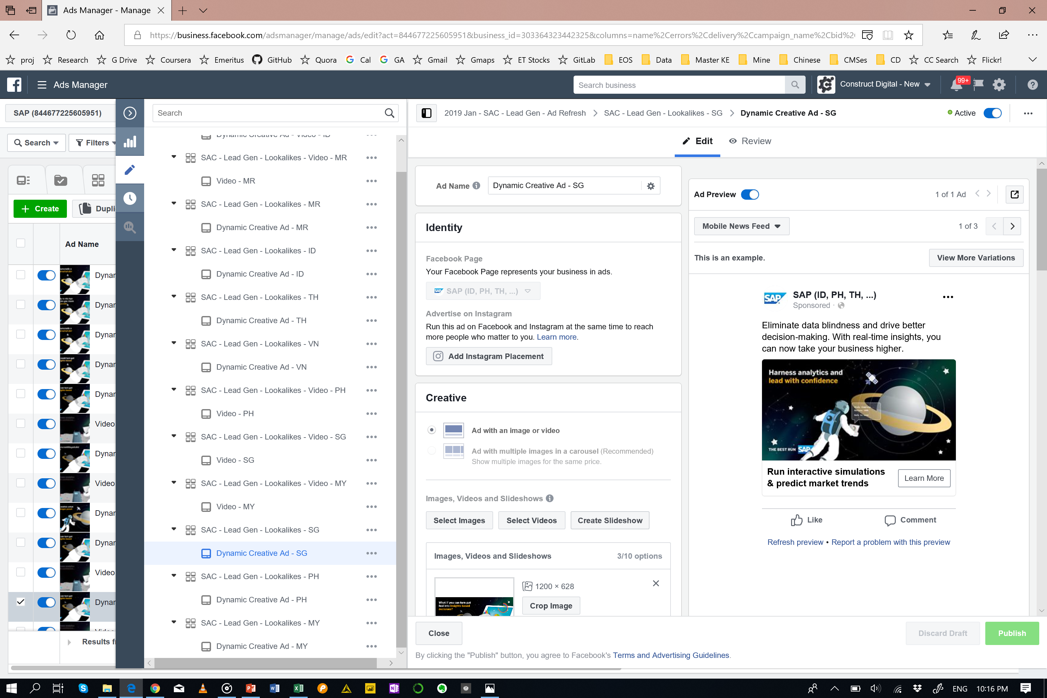

System Overview
Data Preparation
Ad Performance
Machine Learning Algorithm
6
Data Pre-processing
1
Facebook data retrieval
Local Storage
Modelling
5
JOIN Ad Performance + Ad Targeting + Ad Images + Text
2
Feature extraction and engineering
Local Storage
Reiterate till a satisfactory model performance
3
Extract Ad image features and classify images
8
Model evaluation and Tuning
Extract Ad Features
7
Ad Images + Text
9
Models ready to be use by marketers
4
Extract meaning from body text & headlines

Slide 14
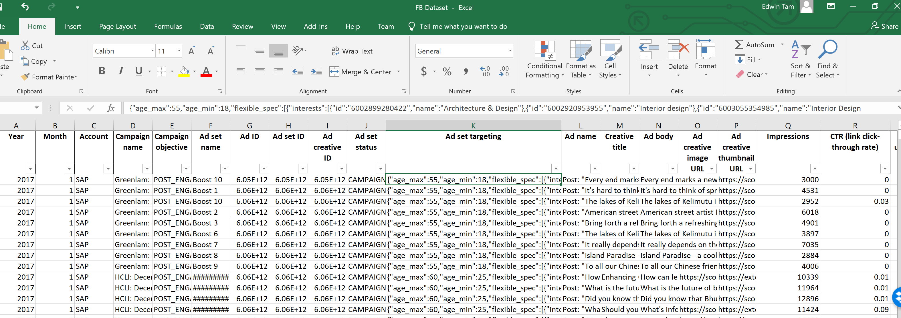
Features Extraction and Engineering
{"age_max":60,"age_min":25,"flexible_spec":[{"interests":[{"id":"6003371567474","name":"Entrepreneurship"},{"id":"6003402305839","name":"Business"},{"id":"6004037932409","name":"Management"}]},{"education_majors":[{"id":"105612759471878","name":"Human resource management"},{"id":"107550232608120","name":"Leadership studies"},{"id":"112307425448585","name":"Industrial and organizational psychology"},{"id":"112892498724794","name":"Management"}],"work_positions":[{"id":"103113219728224","name":"Chief executive officer"},{"id":"104033229633392","name":"Human resources"},{"id":"104133639622995","name":"Talent manager"},{"id":"105612759471878","name":"Human resource management"},{"id":"108595432498170","name":"Senior management"},{"id":"113084235408104","name":"HR & Administration Manager"},{"id":"116885444988542","name":"Director general"},{"id":"134403556642798","name":"Chief human resources officer"},{"id":"210836798933397","name":"Gerente general"},{"id":"330512057159170","name":"Human Resource Director"},{"id":"330839220446732","name":"Sales Director"},{"id":"659208810873456","name":"Human Resources Director (HR Director)"},{"id":"921392397900832","name":"Human Resources Administrator"}]}],"geo_locations":{"countries":["SG"],"location_types":["home","recent"]},"publisher_platforms":["facebook"],"facebook_positions":["feed","right_hand_column"],"device_platforms":["mobile","desktop"]}
Label Encoding of ad parameters Parsing and 1-hot encoding of interests, work titles, and countries

Slide 15
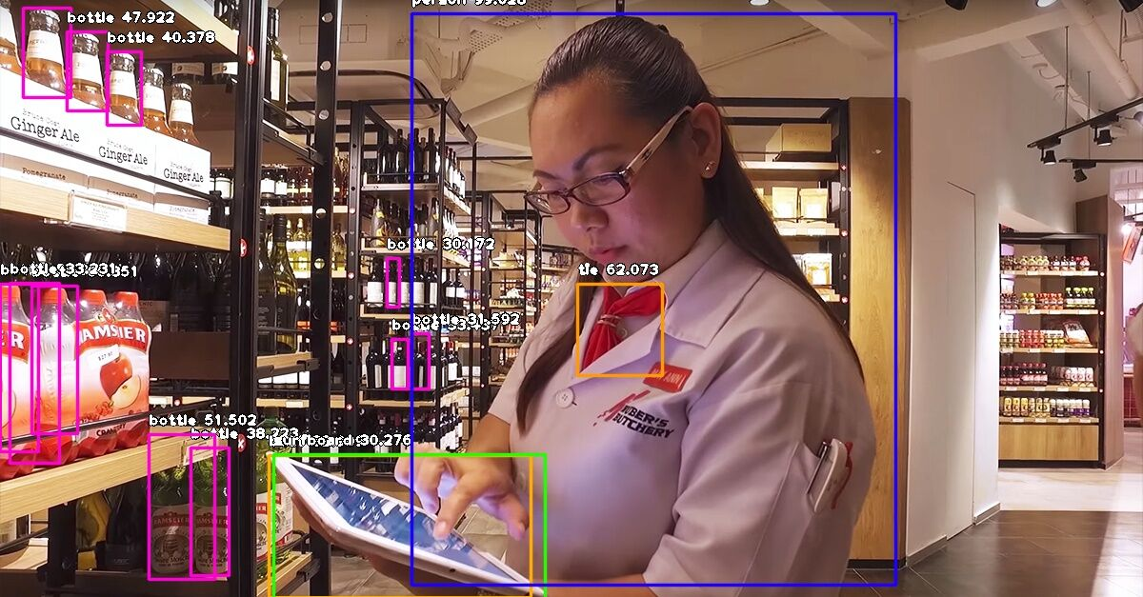
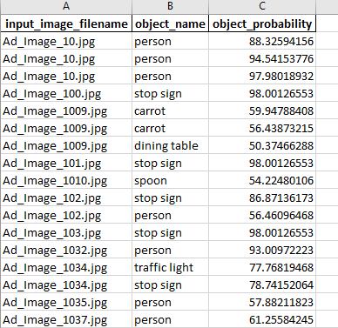

Image Objects Detection
Achieved via ImageAI which supports object detection, video detection and object tracking using RetinaNet, YOLOv3 and TinyYOLOv3 trained on COCO dataset

Slide 16
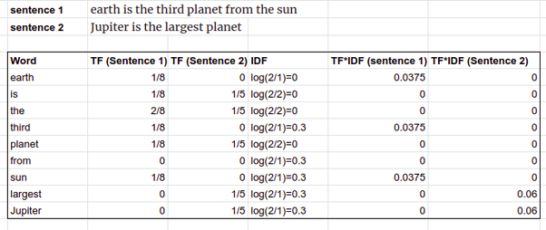
Ad Body Text Mining
Frequentist approach using single tokens with stop words removal. Calculates Term Frequency–Inverse Document Frequency (TF-IDF) statistic for use in model
Image: https://www.quora.com/How-does-TF-IDF-work

Slide 17



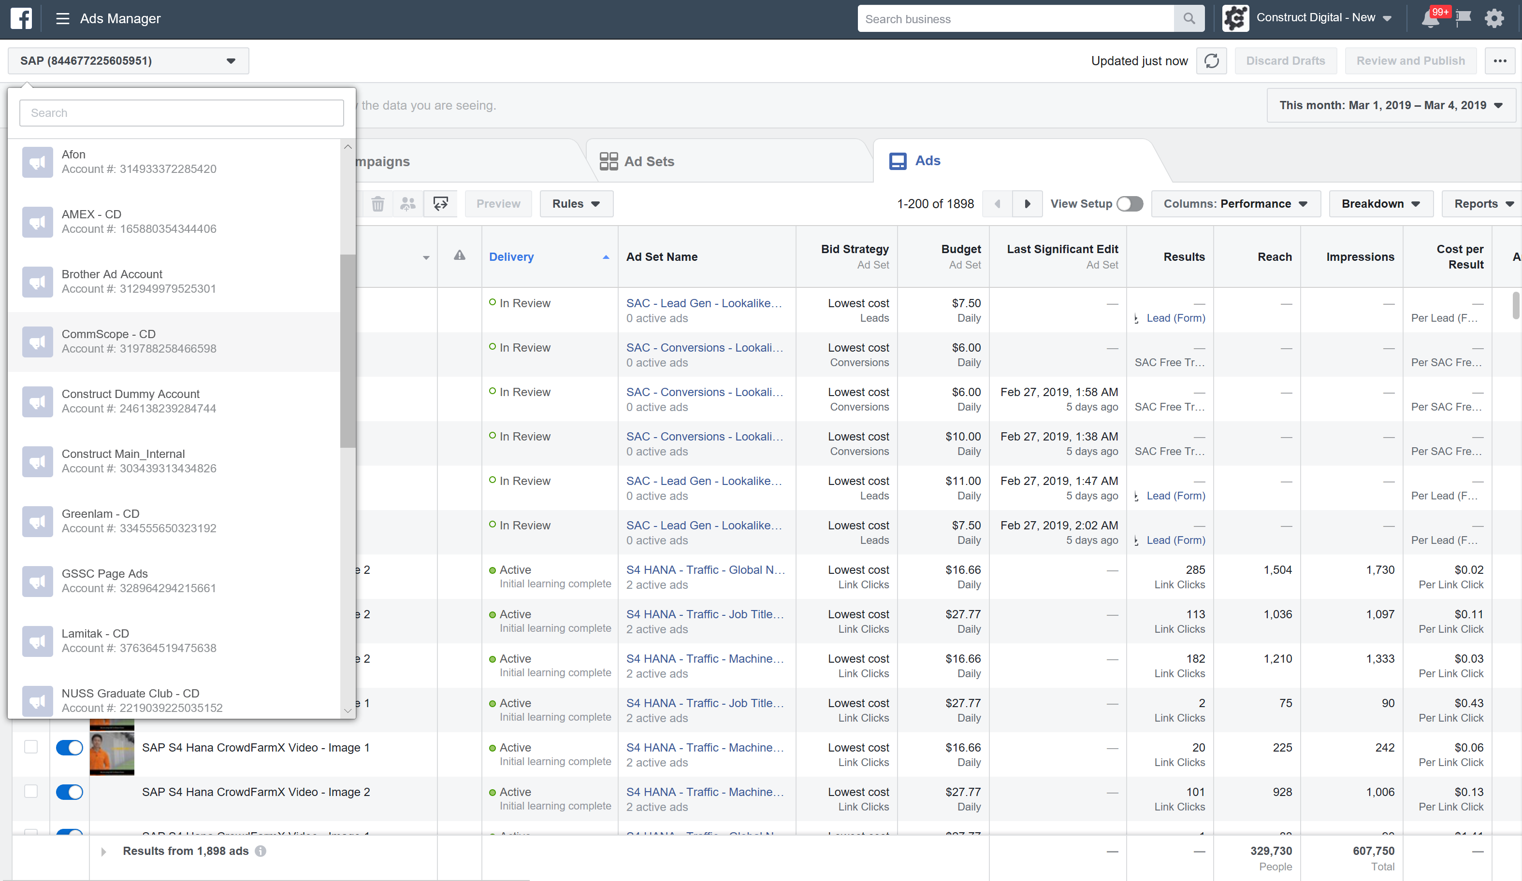
User System Interaction
1
3
Produce CPC prediction
4
Upload ad into Facebook ads manager for campaign launch
Upload their ad images and ad text into their local storage
2
Run Python and KNIME workflow
Facebook Ad Benchmarking System
CPC: $0.40
Ad performance is tracked on Facebook Ad Manager
Local Storage
3.1
Modify ad if necessary.
User action
System action
Post campaign performance data uploaded into local storage to retrain model
Other system action

Slide 18
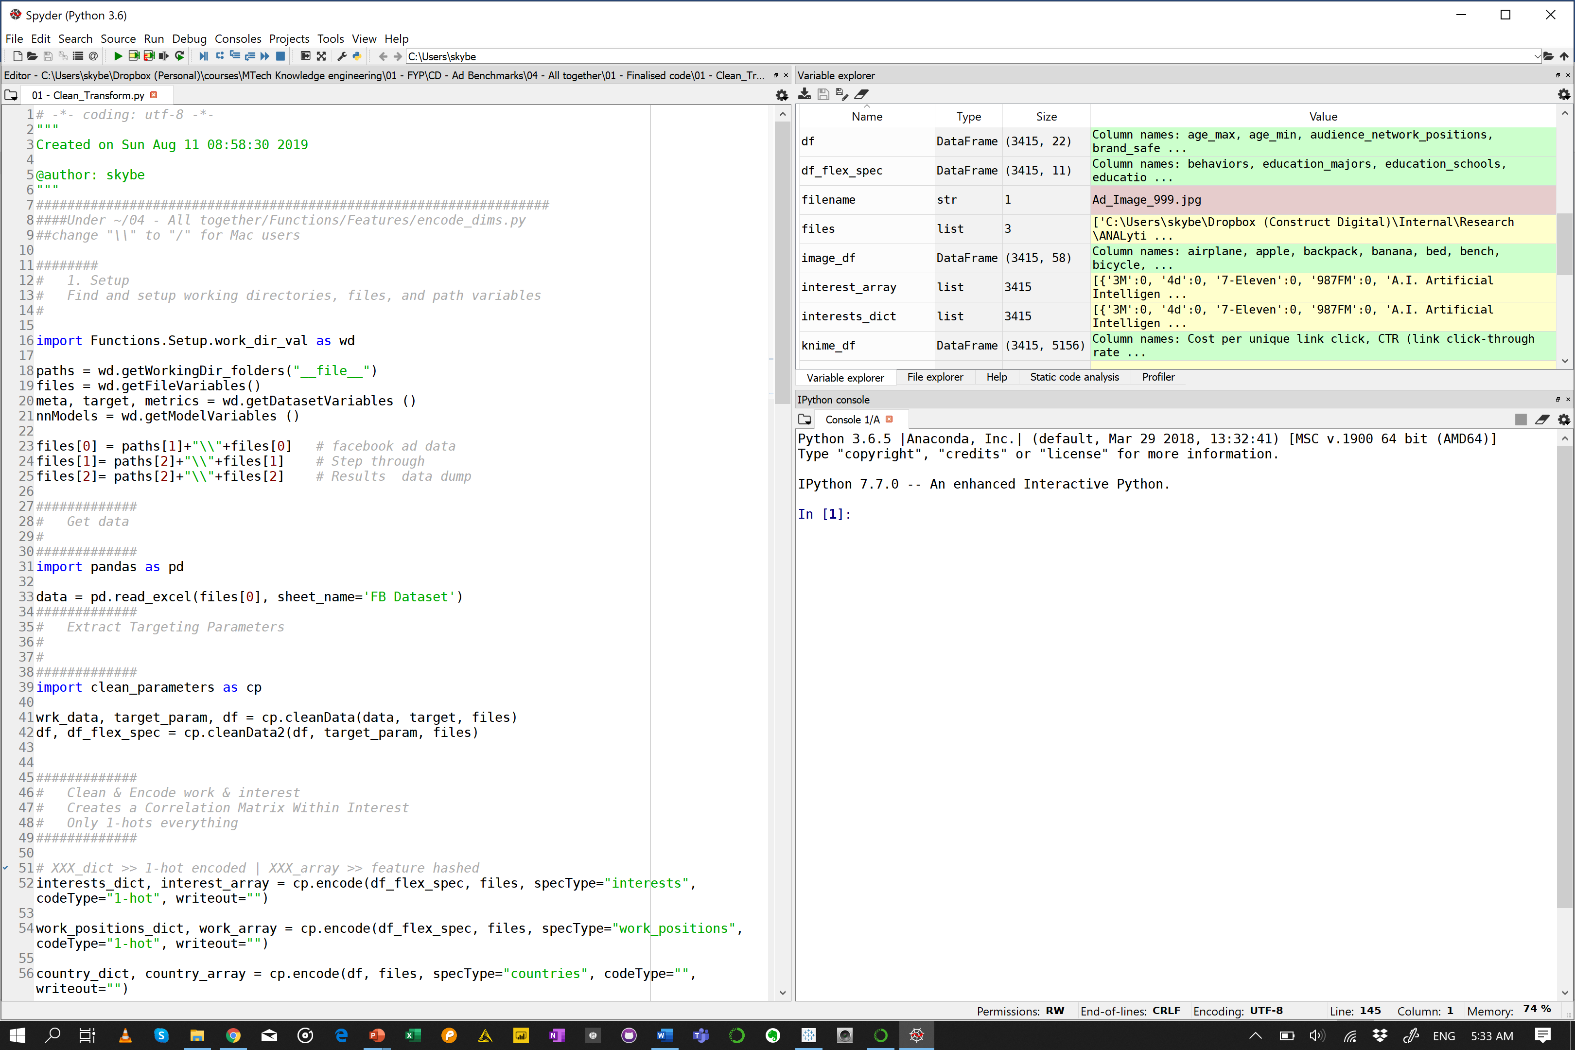
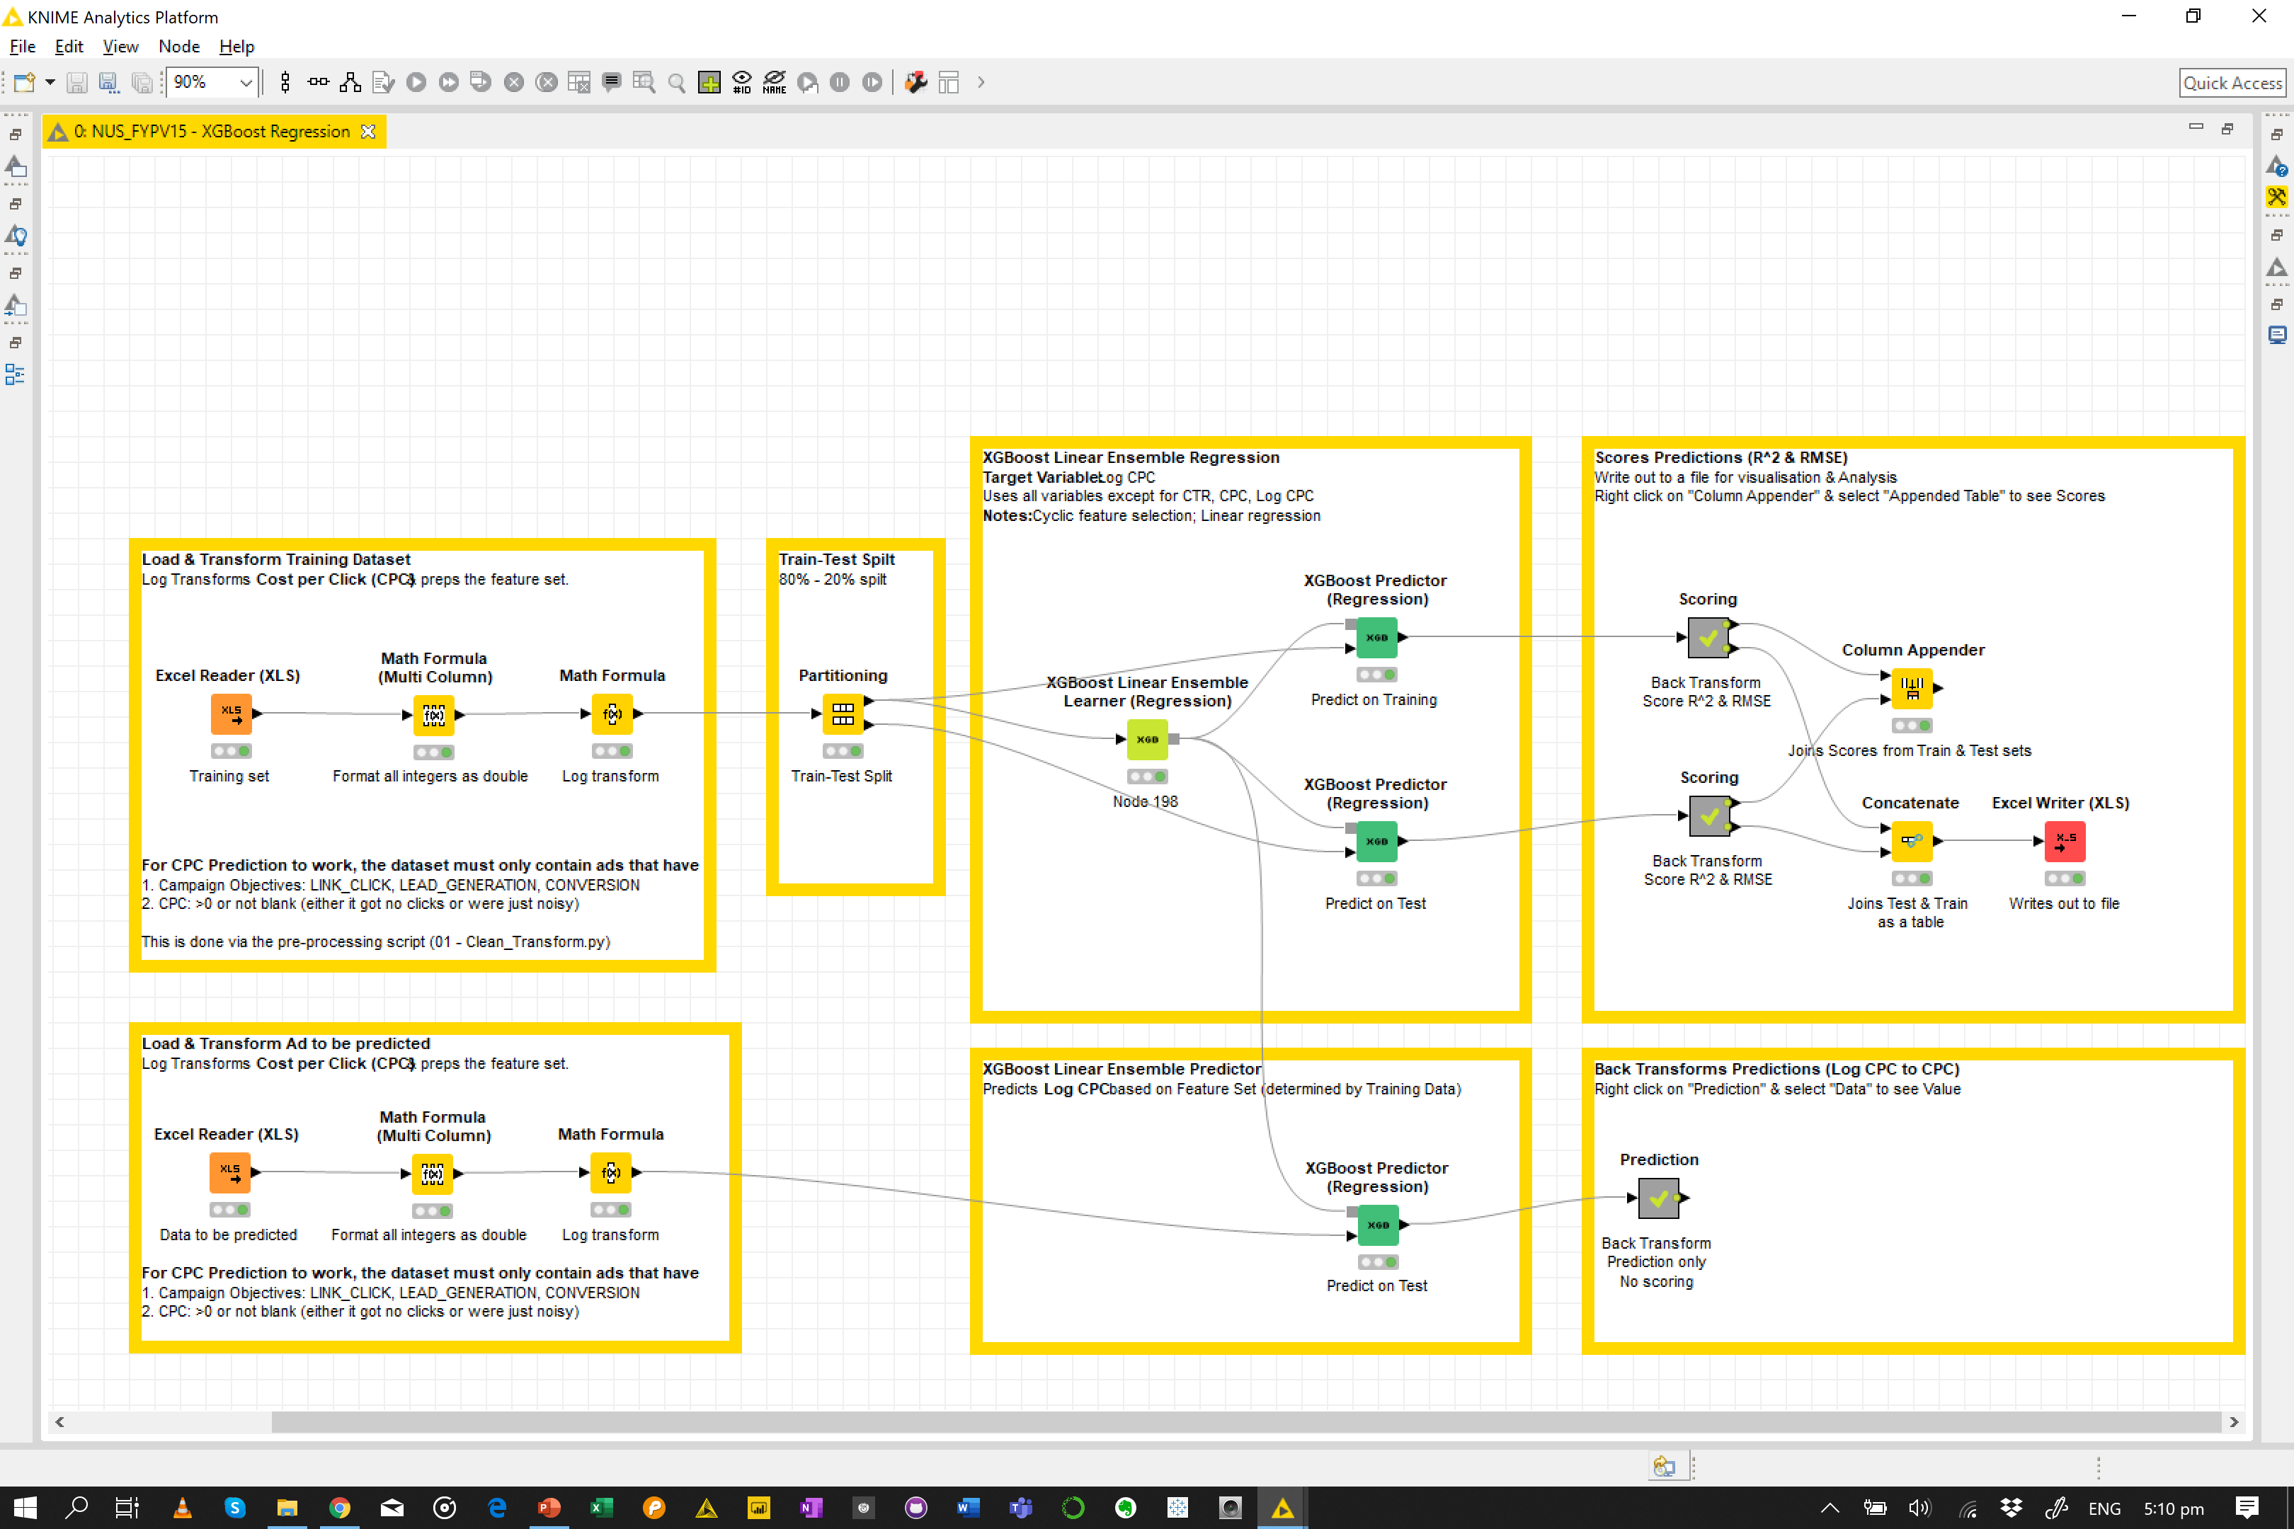
Cleaning to Modelling
Python
Cleaning & Transforming of Dataset
Knime
Model Workflows
For quicker model building and testing, we have switch to the use of KNIME, an open source analytics platform which has most of the machine learning algorithms and allows us to write custom python codes when required, as our main modelling tool besides python.

Slide 19
Cleaning to Modelling
1. Data is extracted from Facebook ads platform using in-house tools by Sponsor
2. Perform feature engineering
a. Targeting parameters (Interest, work titles, countries)
b. Ads images recognition and mapping
c. Extracting text from the ad text and process using TF-IDF techniques
3. Combine processed features with ad performance data (i.e. matrix of features + ad performance). Split the dataset into 80% – 20% (training – validation dataset).
4. Prediction Model
a. Test with machine learning algorithms (once off to select a model that works)
b. Select model
c. Train model; Learn from dataset
5. Prepare for use by Marketers
Python
Cleaning & Transforming of Dataset
Knime
Model Workflows

Slide 20
Prediction
$1.00
$0.40 ~ $1.60
Cost-Per-Click
Cost-Per-Click Tolerance +/- $0.60
Model’s performance is based on R², RMSE
Supervised learning
Linear Regression on Log Transformed CPC Machine learning with XGBoost Linear Ensemble

Slide 21

Results

Slide 22
Previous Phase Our models aren’t very accurate
 | Results
Model | CPC (Features) | CTR (Features)
Linear Regression (Interest) | 0.1146 (48) | 0.1463 (59)
Linear Regression (Work) | 0.1318 (18) | 0.0149 (28)
Linear Regression (Location) | 0.0949 (36) | 0.09492 (36)
Linear Regression (Images) | 0.01499 | 0.01499
Linear Regression (Interest + Work) | 0.1162 (59 + 18) | 0.1457 (59 + 18)
Linear Regression (Work + Country) | 0.2219 (28 + 36) | 0.1071 (28 + 36)
Linear Regression (Interest + Country) | 0.2605 (59 + 36) | 0.1986 (59 + 36)
Linear Regression (Interest + Work + Country) | 0.2465 (48 + 28 + 36) | 0.2643 (59 + 18 + 36)
Mixed Input Model (see “Combine all feature categories) | 0.01017 (ic1) | 0.057944 (iwc1)
The best feature combination only answers 0.2465 of variance.

Slide 23
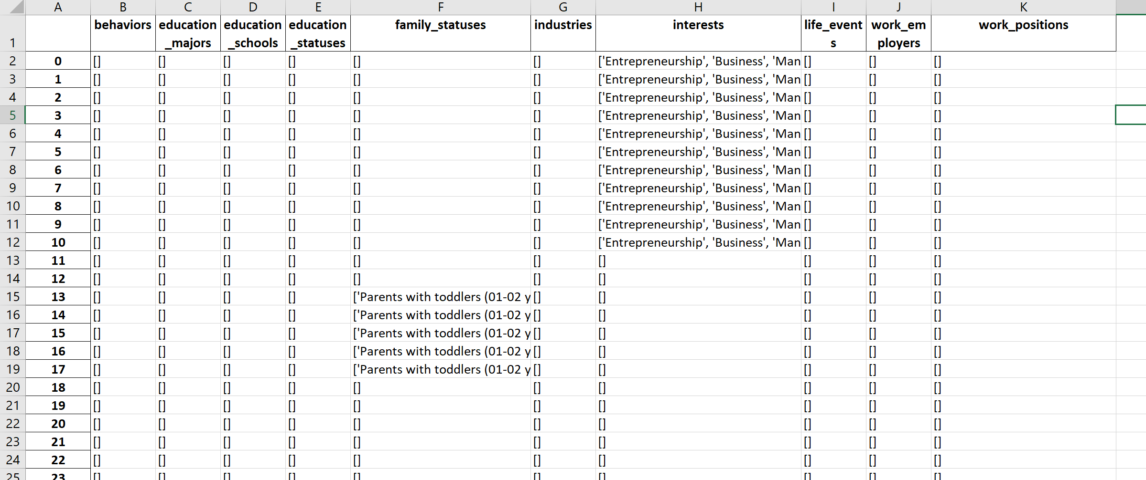
High feature dimensionality & Sparsity
Broken Up Ad Targeting Parameters
Encode parameters using 1-hot encoding
Reduce dimensionality for Interests & Work Positions via
Feature Hashing FeatureHasher from Scikit-learn
Categorise-and-Cluster Manually categorise & use KNN to cluster
PCA Decomposition from Scikit-learn
Large volume of features: 510 Interests, 203 Work Positions, and 52 Image Objects, and the need to use these parameters as model inputs.

Slide 24
Exploring other methods…

Slide 25





Changing Features
Simplify our models
Increase dataset size. 2K > 3K
Include ad body text
Categorized CPCs into equally distributed bins for classification prediction alongside regression predictions.
Focused on ads with the follow objectives: LINK_CLICKS, LEAD_GENERATION, CONVERSIONS.
Trial ensemble and boosted models - XGBoost Linear Ensemble (regression) and XGBoost Tree Ensembles for regression and classification.
Removed rows which had CPC values = 0 or were blank. Either no budget set against the ad, or they performed so badly that no one is clicking
Notes:
Increase dataset size. Originally, we had 2,000+ workable ads, by including this year’s ads – it increased to 3,000+ workable ads.
Focused on ads with the follow objectives: LINK_CLICKS, LEAD_GENERATION, CONVERSIONS. This removes noise caused by other types of ads as Facebook optimizes to set objectives (e.g. REACH).
Removed rows which had CPC values = 0 or were blank. This implies that there was no budget set against the ad, or they performed so badly that they didn’t get a single click – which meant that we can’t calculate CPCs.
Include ad body text as a feature set.
CPC distribution is right skewed with most of the CPCs falling between $0.1 to $4 (90%). Hence, we log transformed CPCs to reduce spread, and expect the model to do badly when predicting high CPCs (i.e. greater than $12)
Instead of using mixed input models, we stuck with basic models that were boosted or ensembled.
In addition, we believed that a classification model (since the spread was so skewed) would be more meaningful.
Categorized CPCs into equally distributed bins for classification prediction. Done alongside regression predictions.
Simplify models. Trial ensemble and boosted models - XGBoost Linear Ensemble (regression) and XGBoost Tree Ensembles for regression and classification respectively.

Slide 26
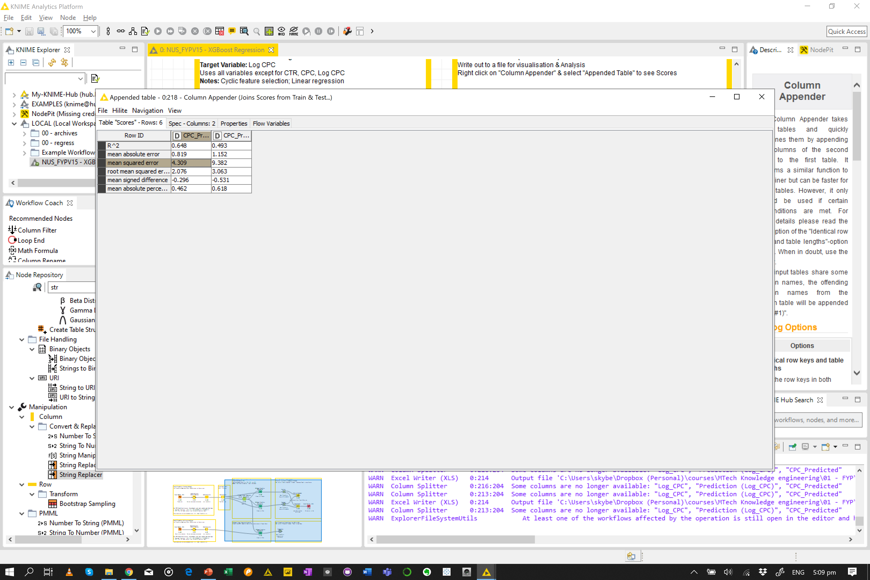
Final Result
Classify or boosted linear ensembles.
Classifier gave 57% accuracy on the categorized CPCs | Linear ensembles provided an R² of .493 on the test dataset. The latter represents a 1.8X increase in performance over the best Phase 2.
Results of XGBoost Linear Ensemble (Regression)
Marketers feedback that they can tolerate some inaccuracy in the predictions. Current threshold is set at +/- $0.60.
We find that the model is suitable for use 65% of the time.
Increase in RMSE is likely due to the lack of data for larger CPCs.

Slide 27
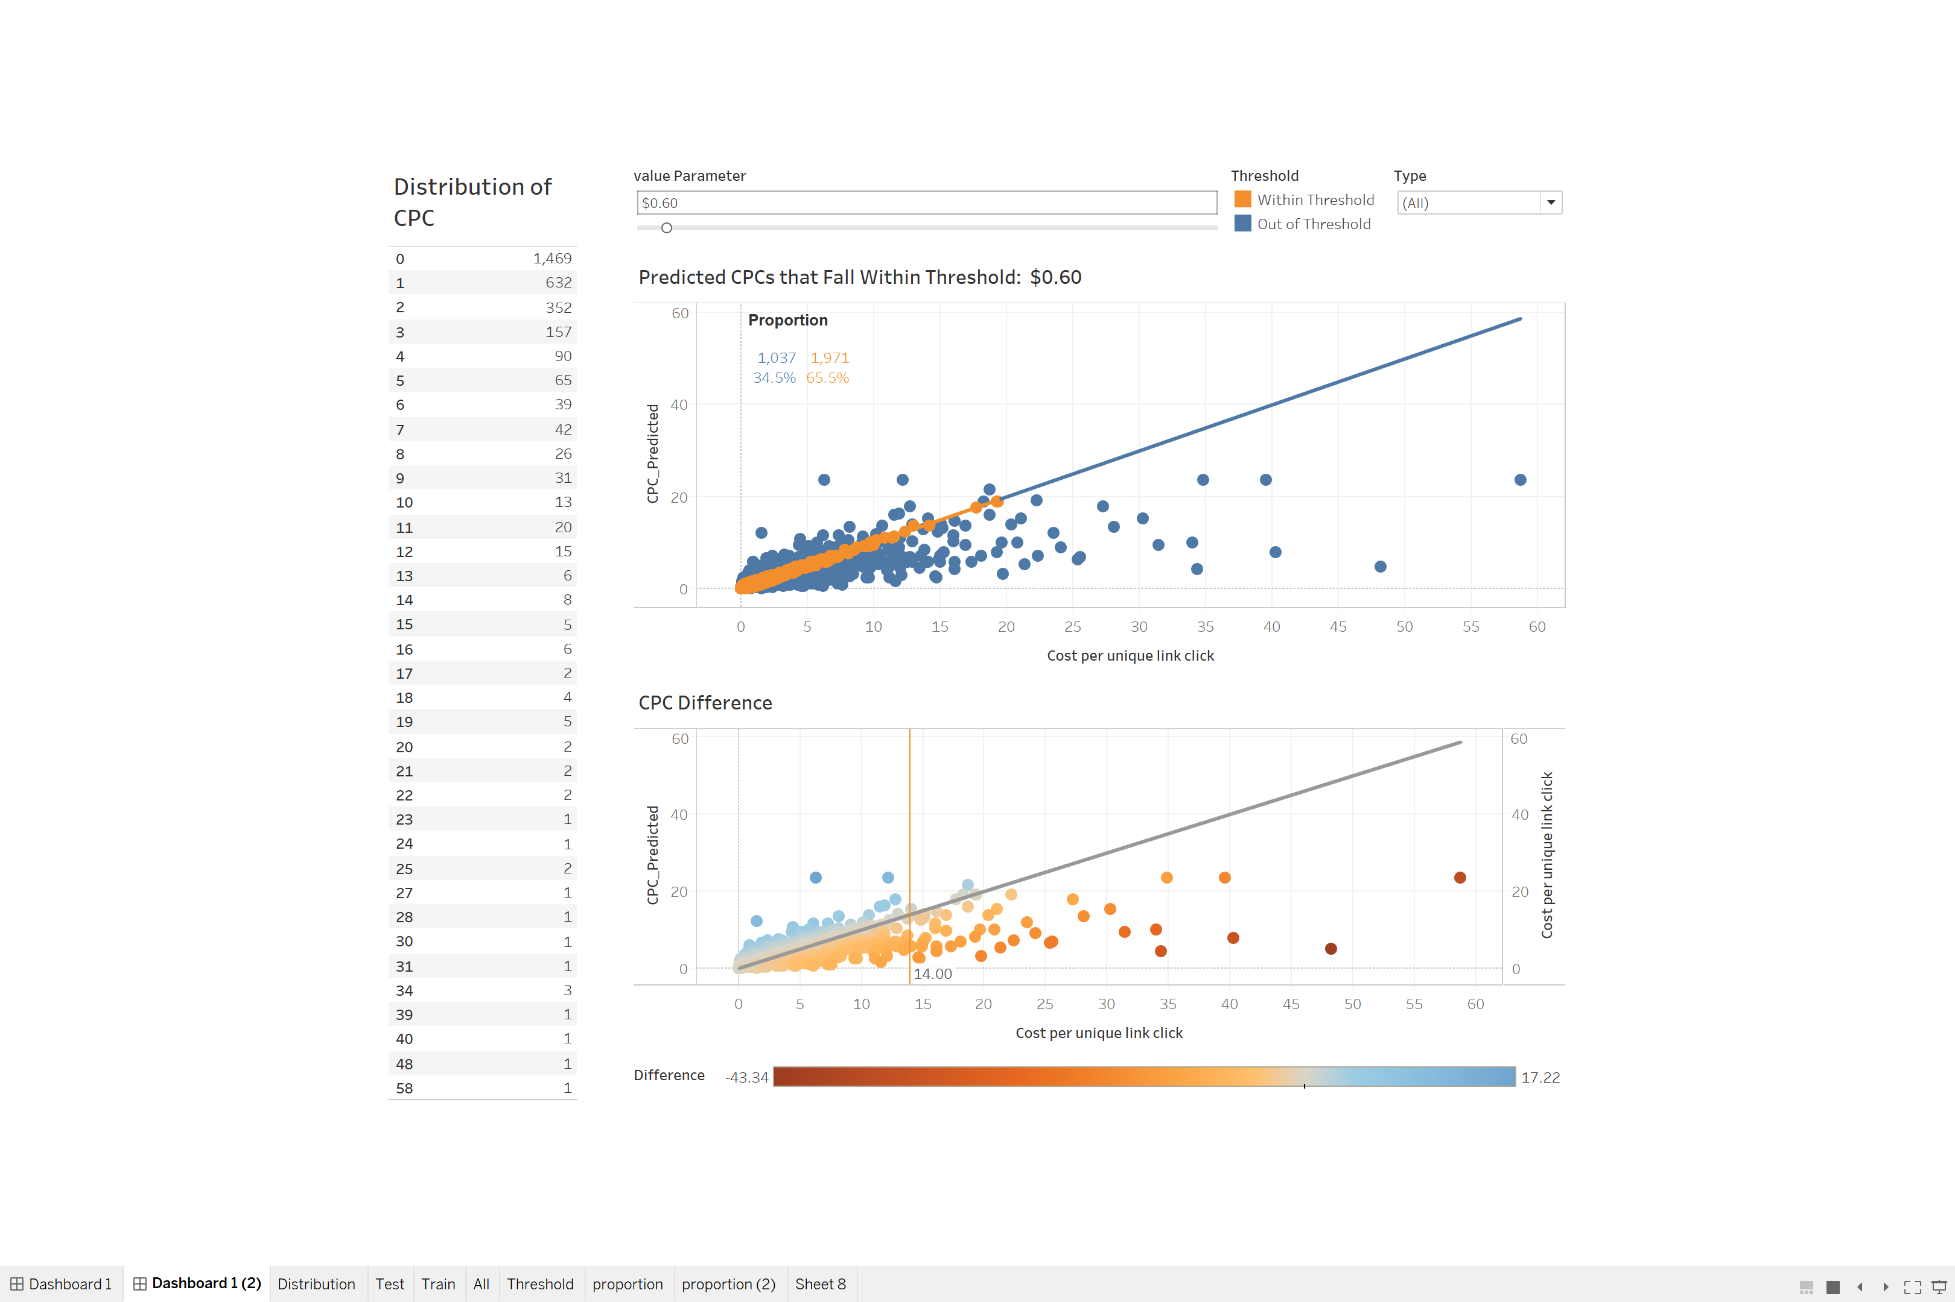
CPCs and imprecision Thresholds (Regression)

Slide 28
Validation
Results from the 10 ads are shown below
Taken from 10 marketing campaigns spread out in 2019
Campaign # | Cost per unique link click (Actual CPC) | Predicted CPC | Difference
112 | 23.51 | 11.98257018 | -11.5274
118 | 12.33 | 12.37465873 | 0.044659
119 | 13.51 | 6.964873139 | -6.54513
133 | 8.95 | 5.308738358 | -3.64126
134 | 5.66 | 5.869095793 | 0.209096
3409 | 0.14 | 0.254500537 | 0.114501
3410 | 0.22 | 0.245758997 | 0.025759
3411 | 0.19 | 0.214330371 | 0.02433
3412 | 0.3 | 0.26010577 | -0.03989
3413 | 0.25 | 0.214330371 | -0.03567
RMSE: 4.34
R²: 0.84
About 70% of this test’s results is within +/- $0.60 threshold

Slide 29


Findings & Recommendations
The biggest performance boost came from text mining the ads.
Predict on Clicks instead of CPC. Use estimated Reach from Facebook as a variable
Make the distinction between text used in ad headlines over body copy.
Refine the text mining approach. Use phrases or co-occurrences instead of just tokens
Partition the dataset by campaign objectives and run the model accordingly.
Include a simulation module such that end users can input parameters without help
Notes:
Predict on Clicks instead of CPC. Use estimated Reach from Facebook as a variable
Make the distinction between text used in ad headlines over body copy.
Refine the text mining approach. Use phrases or co-occurrences instead of just tokens
Partition the dataset by campaign objectives and run the model accordingly.
Include a simulation module such that end users can input parameters without help

Slide 30






Limitations
As our dataset grows larger, we expect that the current model will miss out on objects in images and rare targeting parameters
Current training dataset only uses a subset of Facebook’s available options.
Model will need to be retrained regularly.
Encompasses certain creative and industrial biases.
CPC distribution of the dataset is skewed towards lower values.
Mis-prediction of novel ads or ads that are not well represented for certain industries.
Notes:
As our dataset grows larger, we expect that the current model will miss out on objects in images and rare targeting parameters
Current training dataset only uses a subset of Facebook’s available options.
Model will need to be retrained regularly. This should be done in such a way that it does not involve any human intervention.

Slide 31
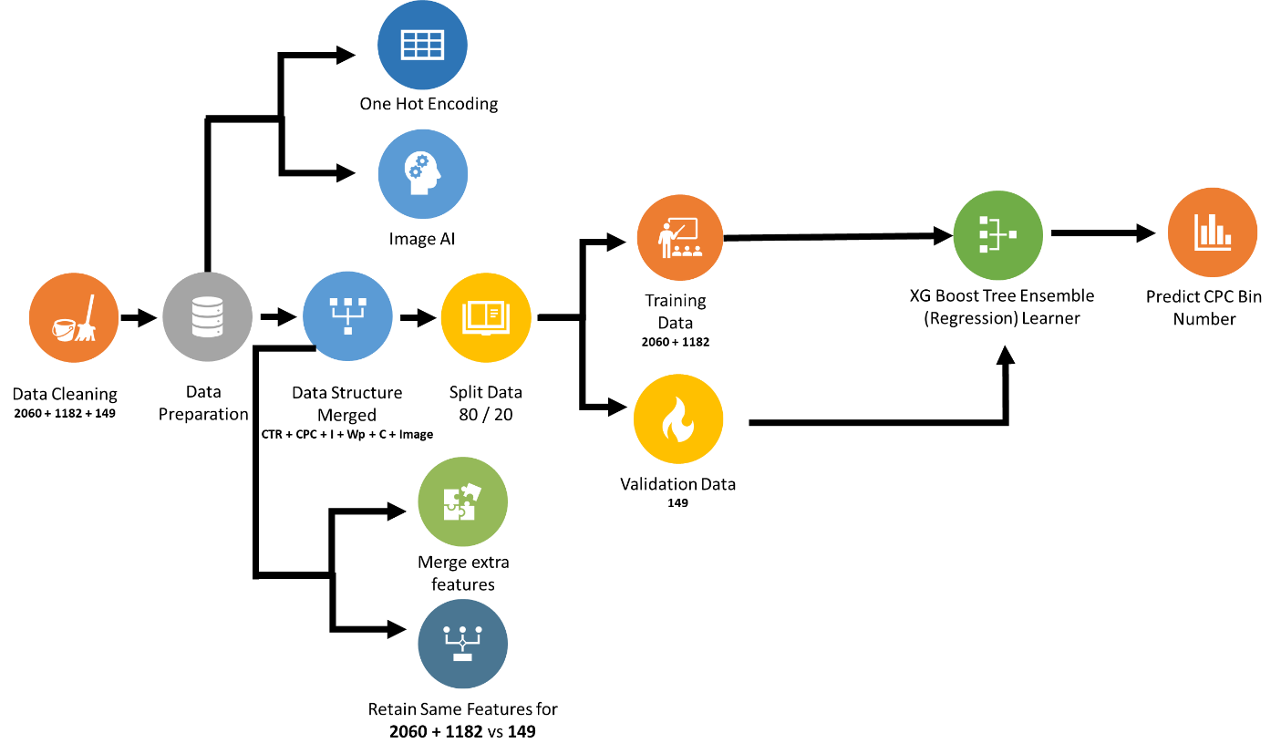
Final Process Flow

Slide 32
KNIME Data Model Workflow

Slide 33

Benefits

Slide 34
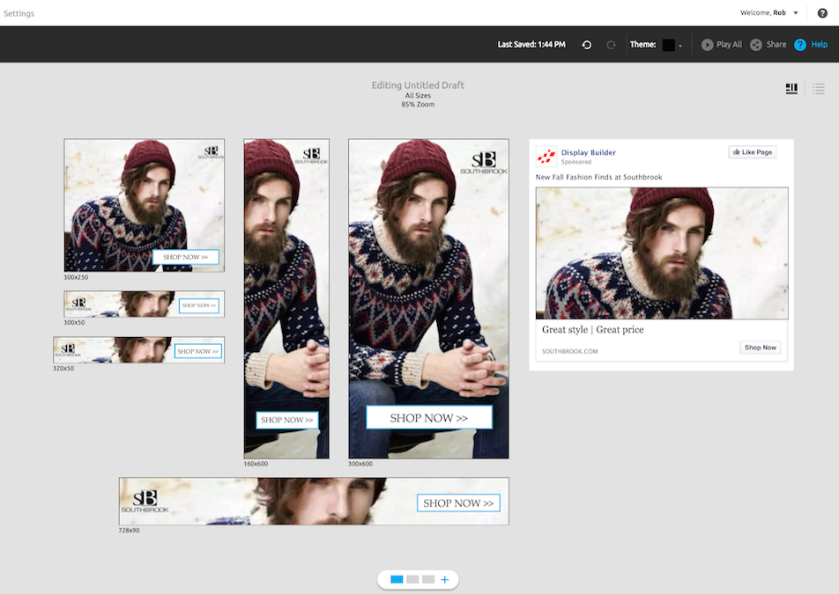


Is it worth building ad prediction system?
Only have access to simple reports on metrics such as audience Reach. Marketers tend to rely on their gut feel
Ad Creative feature mining is still relatively experimental.
Ad has the largest effect on ad performance
Creative Management that is relatively expensive
It costs anywhere between SGD 5,000 to 100,000 per month to run a campaign
Notes:
Facebook, LinkedIn, Twitter will not tell you the future performance of an ad Despite the abundance of ad performance data, marketers only have access to simple reports on these platforms and metrics such as audience Reach. Hence marketers tend to rely on their “gut” and past experience to predict the “goodness” of an ad.
Ad Creative feature mining is still relatively experimental There are efforts to correlate ads and ad parameters to ad performance, but intuitively, the ad has the largest effect on ad performance
Cost-effective commercial platforms are the exception The closest tools are likely Programmatic Advertising platforms (e.g. DataXu) or Creative Management Platforms (CMP e.g. Thunder). However, these platforms are:
Primarily used to run ad campaigns. Any intelligence is by-the-way and subject to the whims of the platform.
Relatively expensive. It costs anywhere between SGD 5,000 to 100,000 per month to run a campaign (costs are based on regions, audience segments, and number of creatives)

Slide 35

Conclusions

Slide 36




Key Takeaway / Challenges
Marketers get the most out of their marketing dollars.
Trial and test of several different models and many features to crunch
Simplicity rules over mixed models.
Features matter, and 80% of time is spent on data wrangling and munging!
Step ahead for the sponsor’s ambitions to create a suite of marketing intelligence tools.
Notes:
Marketers can perhaps “game” Facebook to get the most out of their marketing dollars.
Trial and test of several different models and many features to crunch that takes great effort and imagination to prepare the dataset for use.
Simplicity rules over mixed models.
Features matter, and 80% of time is spent on data wrangling and munging!
Project is a step ahead for the sponsor’s ambitions to create a suite of marketing intelligence tools.

Slide 37

Demo

Slide 38

Thank You | Q&A

